Slide 1
Database Normalisation

Slide 2
Introduction
Two levels of relation schemas
The logical "user view" level
The storage "base relation" level
General Guidelines:
Informally, each tuple in a relation should represent one entity or relationship instance.
Attributes of different entities (EMPLOYEEs, DEPARTMENTs, PROJECTs) should not be mixed in the same relation
Only foreign keys should be used to refer to other entities
Entity and relationship attributes should be kept apart as much as possible.

Slide 3
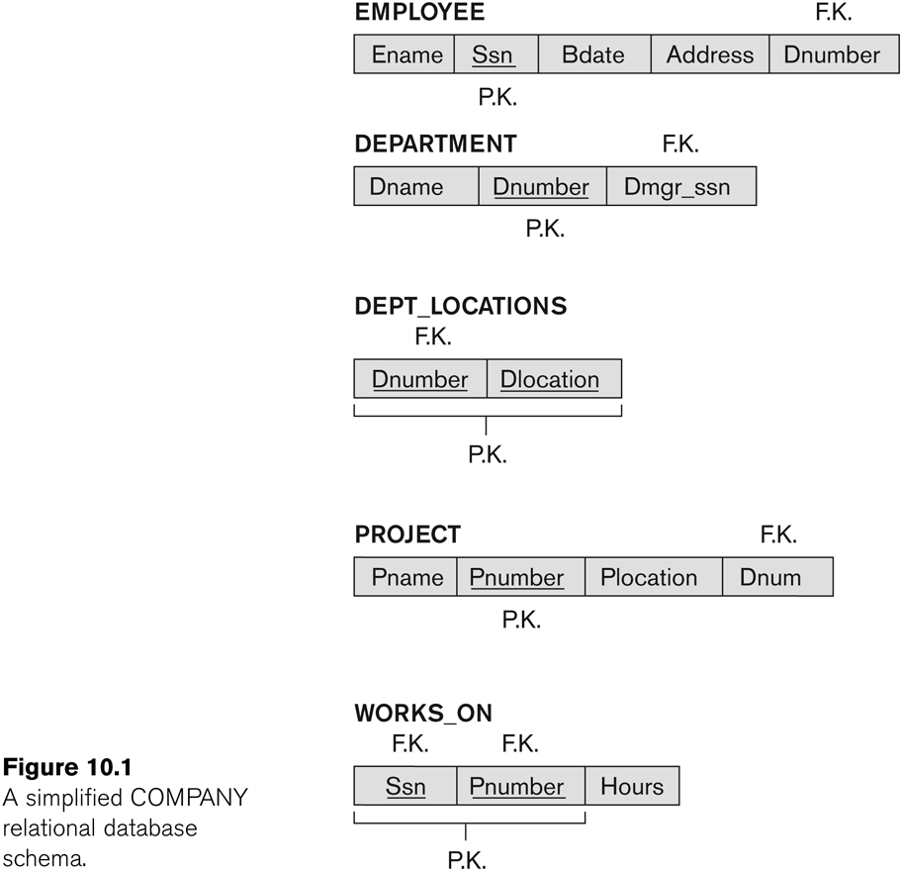
A simplified COMPANY relational database schema

Slide 4
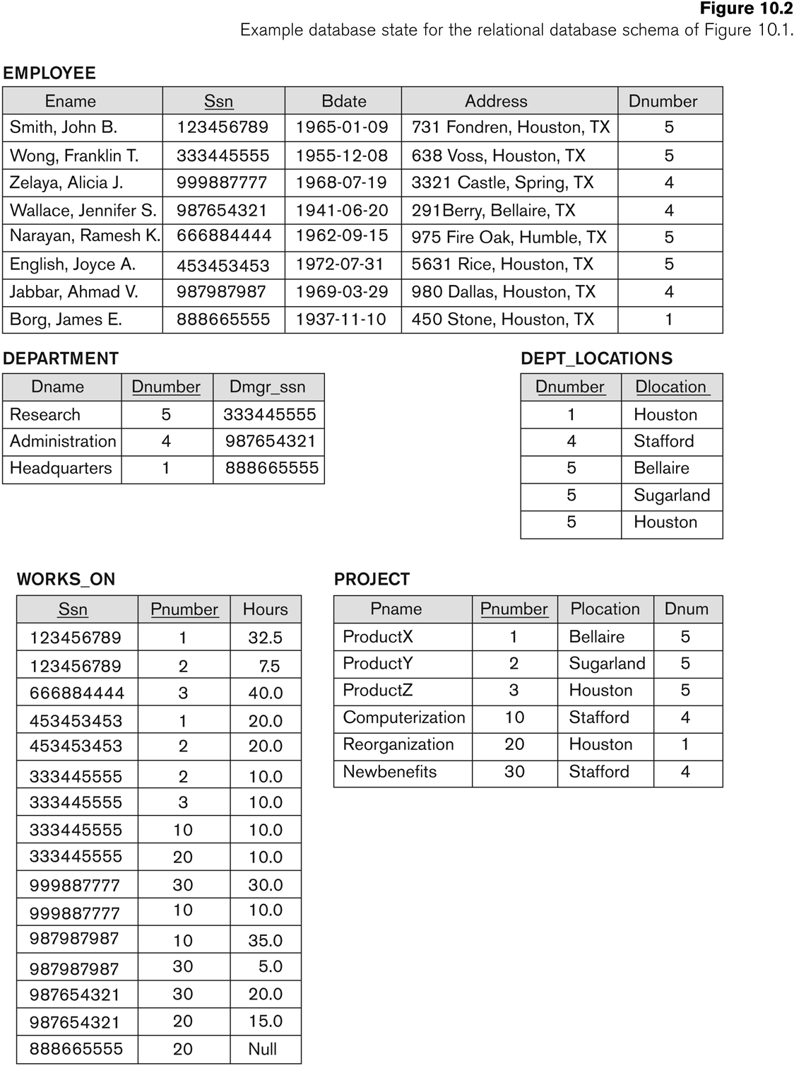

Slide 5
What is normalisation
Divide into tables
Relations among tables using primary/foreign keys
Minimal redundancy
Grouping correlated data in one place
One place for modifications
Based on functional dependencies

Slide 6
Functional dependency
A ➔ B means that each value of A is always associated with one value of B. The opposite is false.
A ➔ B holds if whenever two tuples have the same value for A, they must have the same value for B
Read as:
- B is functionally dependent on A
- A is a determinant of B
Partial functional dependency occur when A is composite of more than one attribute, and B is functionally dependent on one attribute of A’s attributes.
Full Functional Dependency is when B is functionally dependent on A, and not any proper subset of A.
Transitive dependence: A→B→C, it is between A and C via B

Slide 7
Functional dependency
Examples:
{SSN, PNUMBER} -> HOURS is a full FD since neither SSN -> HOURS nor PNUMBER -> HOURS hold
{SSN, PNUMBER} -> ENAME is not a full FD (it is called a partial dependency ) since SSN -> ENAME also holds

Slide 8
Process of normalisation
UNF
1NF
2NF
3NF
Remove repeating groups (Multi-valued)
Remove partial dependencies
Remove transitive dependencies

Slide 9
UNF
A table (relation) that contains one or more repeating groups
Vertically: some blank cells
Horizontally: no blank cells

Slide 10
1NF
Remove repeated groups
To make the UNF in 1NF:
Vertically: simply fill the blanks

Slide 11
1NF
To make the UNF in 1NF:
Horizontally: separate into two tables
Put the repeated groups in separate table with a foreign key

Slide 12
So far ...
The relation has a primary key
If the key is with single-attributes, the relation now in, at least, 2NF
If the key is composite-key, the relation now in, at least,1NF
Functional dependency is not used so far
1NF:
A relation in which the intersection of each row and column contains one and only one value

Slide 13
2NF
Remove partial dependencies
That is; every non-key attribute depends on the whole of the primary key, and not just a part (subset) of it. In other words, fully functional dependency.
2NF
A relation that is in 1NF and every non-primary-key attribute is fully functionally dependent on the primary key. Still, transitive dependency might exist.

Slide 14
Part of example on 2NF
1NF
2NF

Slide 15
Part of example on 2NF
1NF
2NF

Slide 16
3NF
Remove transitive dependencies
OR
non-key attributes are dependent on the key only
OR
Remove the non-key attributes that do not depend on the key
3NF:
A relation that is in 1NF and 2NF and in which no non-primary-key attribute is transitively dependent on the primary key

Slide 17
Part of example on 3NF
1NF
2NF

Slide 18
Part of example on 3NF
2NF
3NF

Slide 19
Examples

Slide 20
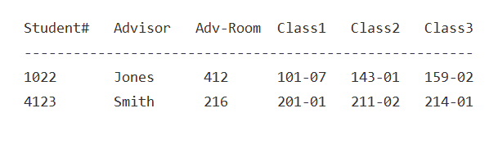
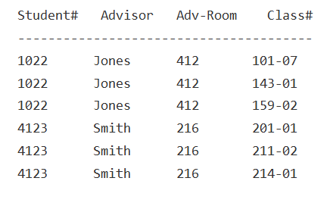
Example 1
UNF
1NF

Slide 21
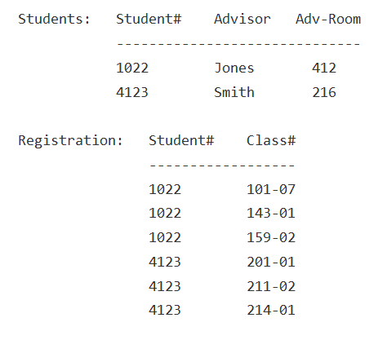
Example 1
2NF

Slide 22
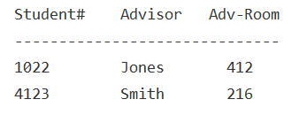
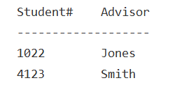
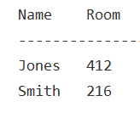
Example 1
2NF
3NF

Slide 23
Example 2 (assumption 1)
One action may shift the relation two levels.
More than one action might be taken to shift the relation one level.
In the following example, we assumed that the employee can work only in one department. Therefore, the PK is the emp# and the relation is in the 2NF (no partial functional dependency).

Slide 24
Example 2 (emp# is the PK)
Employee table
2NF
emp# | emp_name | salary | dept# | dept_name | dept_mngr | Mngr_address
Employee table
emp# | emp_name | salary | dept#
Department table
dept# | dept_name | dept_mngr | Mngr_address
Department table
3NF
Employee table
dept# | dept_name | dept_mngr
emp# | emp_name | salary | dept#
Manager table
dept_mngr | Mngr_address

Slide 25
Example 2 (assumption 2)
Assuming that the employee can work in more than one department makes the PK(emp#, dept#) and thus, the relation is in the 1NF (there is partial functional dependency).

Slide 26
Example 2 ((emp#, dept#) is the PK)
Employee table
1NF
emp# | emp_name | salary | dept# | dept_name | dept_mngr | Mngr_address
Employee table
emp# | emp_name | salary
2NF
Department table
Original table
dept# | dept_name | dept_mngr | Mngr_address
emp# | dept#
Employee table
emp# | emp_name | salary
Original table
3NF
emp# | dept#
Manager table
Department table
dept_mngr | Mngr_address
dept# | dept_name | dept_mngr

Slide 27
Example 3
3NF
car# | Model | Colour | Engine_id | Max_speed | Petrol_type | Width

Slide 28
Example 4
Assume that the Dept. # and Cust. # are all needed to uniquely identify the date and nature of the complaint about the department.
Dept # | Dept Name | Location | Mgr Name | Mgr ID No. | Tel Extn. | Cust # | Cust Name | Date of Complaint | Nature of Complaint
11232 | Soap Division | Cincinnati | Mary Samuel | S11 | 7711 | P10451 | Robert Drumtree | 12/01/1998 | Poor Service
 |  |  |  |  |  | P10480 | Steven Parks | 14/01/1998 | Discourteous Attendant
UNF
Fill the blanks to be in 1NF
Dept # | Cust # | Date of Complaint | Nature of Complaint
Dept # | Dept Name | Location | Mgr Name | Mgr ID No. | Tel Extn.
Cust # | Cust Name
2NF
Dept # | Cust # | Date of Complaint | Nature of Complaint
Dept # | Dept Name | Location | Mgr ID No. | Tel Extn.
Cust # | Cust Name
Mgr ID No. | Mgr Name
3NF

Slide 29
Anomaly

Slide 30
Redundant Information in Tuples and Anomalies
If information is stored redundantly
Wastes storage
Causes problems with update anomalies
Insertion anomalies
Deletion anomalies
Modification anomalies

Slide 31
EXAMPLE OF AN UPDATE ANOMALY
Consider the relation:
Storing project name and employee name in the Emp_Proj table:
EMP_PROJ (Emp#, Proj#, Ename, Pname, No_hours)
Update Anomaly:
Changing the name of project number P1 from “Billing” to “Customer-Accounting” may cause this update to be made for all 100 employees working on project P1.
Same goes for changing an employee name.

Slide 32
EXAMPLE OF AN INSERT ANOMALY
Consider the relation:
EMP_PROJ (Emp#, Proj#, Ename, Pname, No_hours)
Insert Anomaly:
Cannot insert a project unless an employee is assigned to it.
Cannot insert an employee unless a he/she is assigned to a project.

Slide 33
EXAMPLE OF AN DELETE ANOMALY
Consider the relation:
EMP_PROJ(Emp#, Proj#, Ename, Pname, No_hours)
Delete Anomaly:
When a project is deleted, it will result in deleting all the employees who work on that project.
Alternately, if an employee is the only employee on a project, deleting that employee would result in deleting the corresponding project.

Slide 34
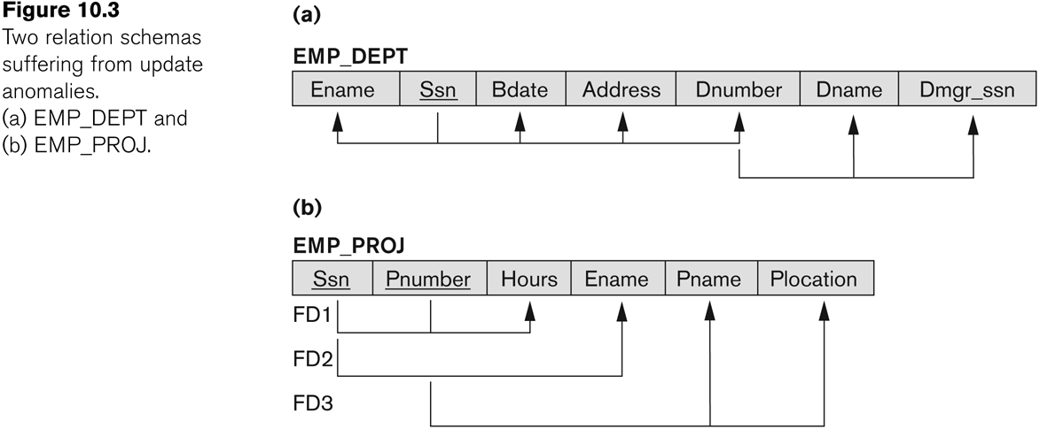
Two relation schemas suffering from update anomalies

Slide 35
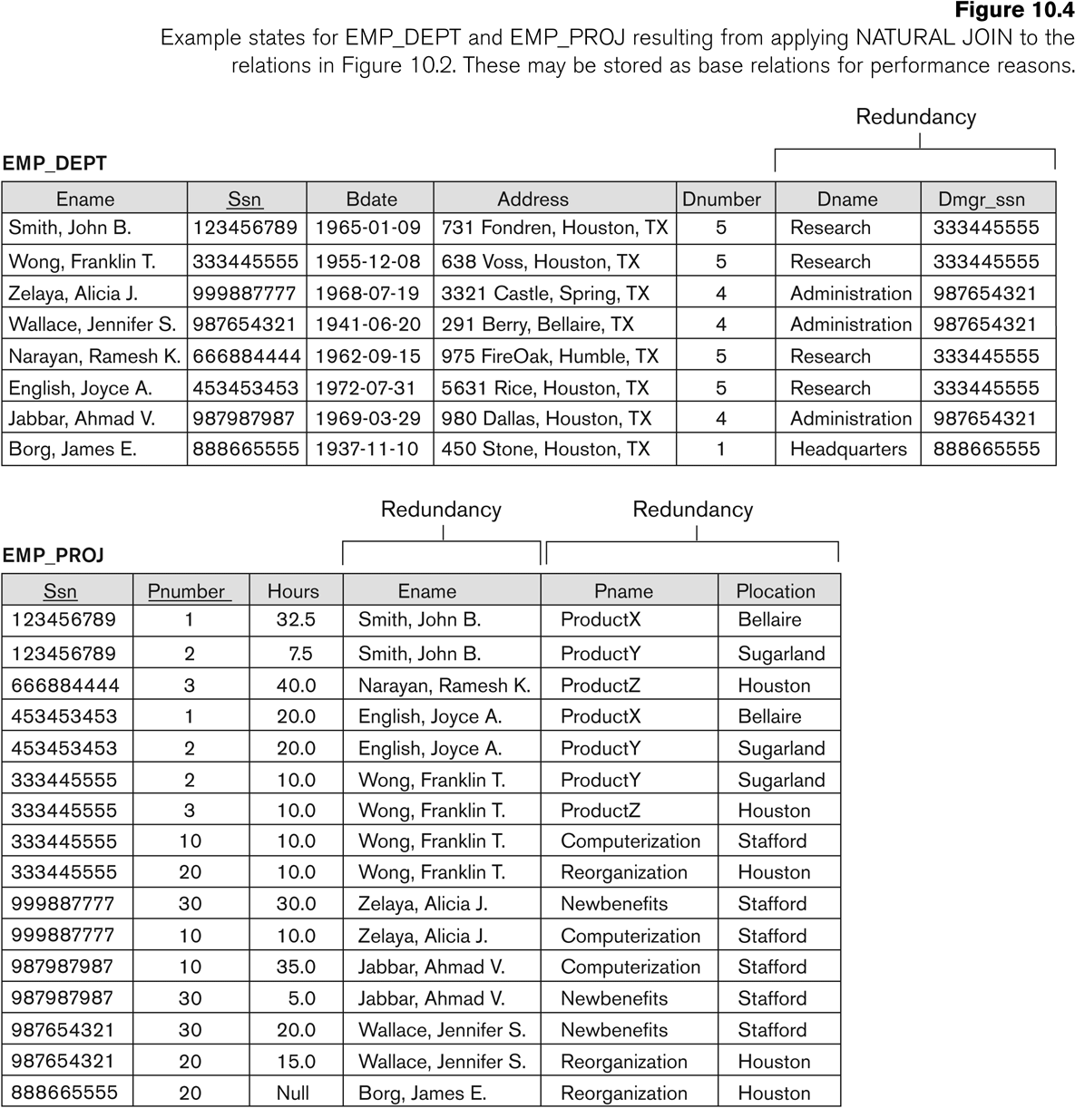
Relations formed after a Natural Join

Slide 36
The End

